Slide 1
Social Assistance Grants for Empowerment
Overview of key achievements; emerging impacts and national rollout plans

Slide 2
Rationale and strategic importance of SP in national development
MGLSD’s vision is to establish a Social Protection system as part of the core government policy and planning processes to:
reduce vulnerability to shocks and thereby prevent deterioration of living standards and reduce poverty
support households to build more secure and resilient livelihoods.

Slide 3
Expanding Social Protection Programme
In June 2010, the Expanding Social Protection (ESP) Programme was established within the MGLSD in recognition of the need to establish a coherent policy and fiscal framework for Social Protection.
The ESP is responsible for implementing the Social Assistance Grant for Empowerment (SAGE) programme, in 15 districts.
Purpose of SAGE is to test delivery systems and generate evidence of feasibility and impact
ESP is jointly funded by the government and development partners -DFID , Irish Aid, and UNICEF.

Slide 4
Summary of KEY achievements

Slide 5
Key achievements
Capacity for management and leadership for Social Protection has being built at both central and local government levels

Slide 6
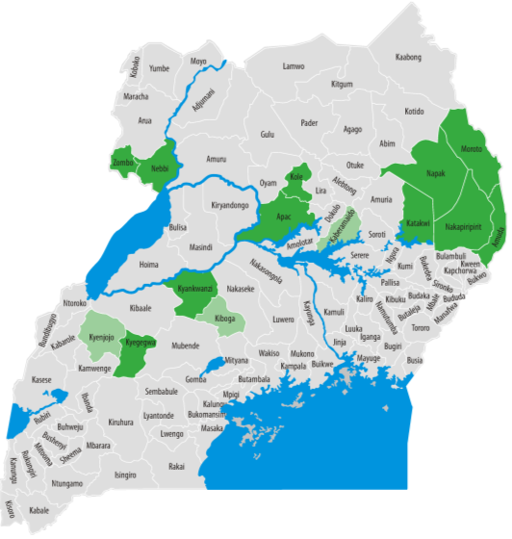
Key achievements
110,334 beneficiaries
15 districts
141 sub-counties and town councils
6,040 villages
Retargeting exercise completed: Enrolment of new SCG beneficiaries in all 14 districts

Slide 7
Key achievements
Robust systems and processes for beneficiary registration and payment ready to implement SAGE nationally.
MTN Mobile Money system is accessible to most beneficiaries with 90% reliability.
UGX 63.3 bn
transferred to date
2.75 Bn monthly

Slide 8
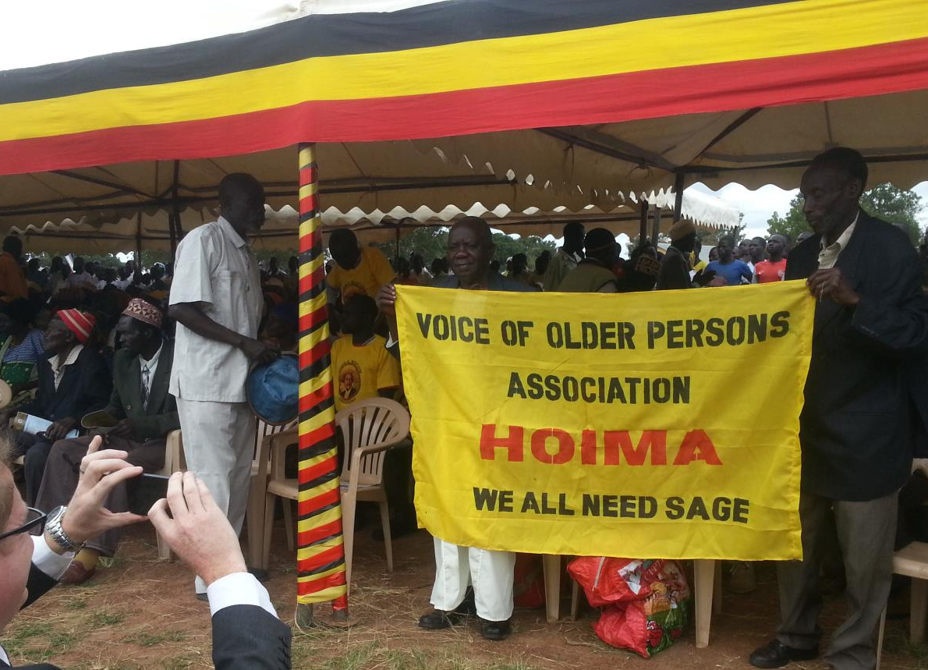
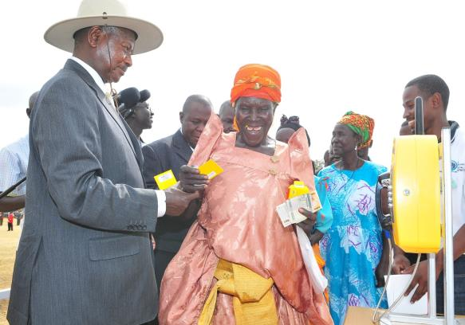
Key achievements
Overwhelming appreciation of the programme within SAGE pilot districts
H.E. the President directed the MGLSD and MFPED to:
extend the SAGE pilot to a new district -Yumbe
develop and publish a plan for national rollout of the SCG

Slide 9
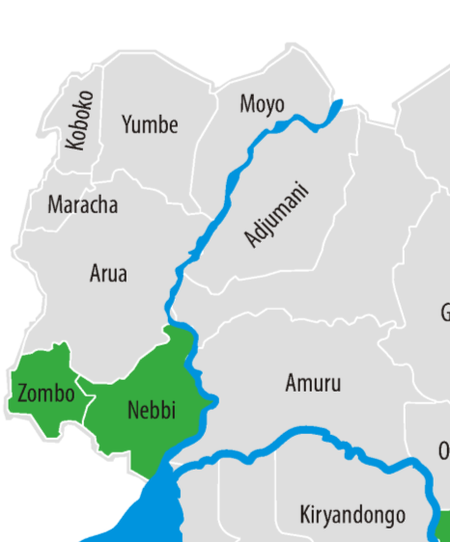
Key achievements-Yumbe is
MGLSD is using UGX 2bn counterpart funds to cover Yumbe
A dedicated office established
6420 beneficiaries receiving payments in 7 sub counties since August 2014
enrolment of 5000 beneficiaries in 6 sub-counties awaiting release of additional funds from MFPED

Slide 10
Pictorial, Yumbe Launch

Slide 11
EMERGING IMPACTS OF THE SAGE PROGRAMME

Slide 12
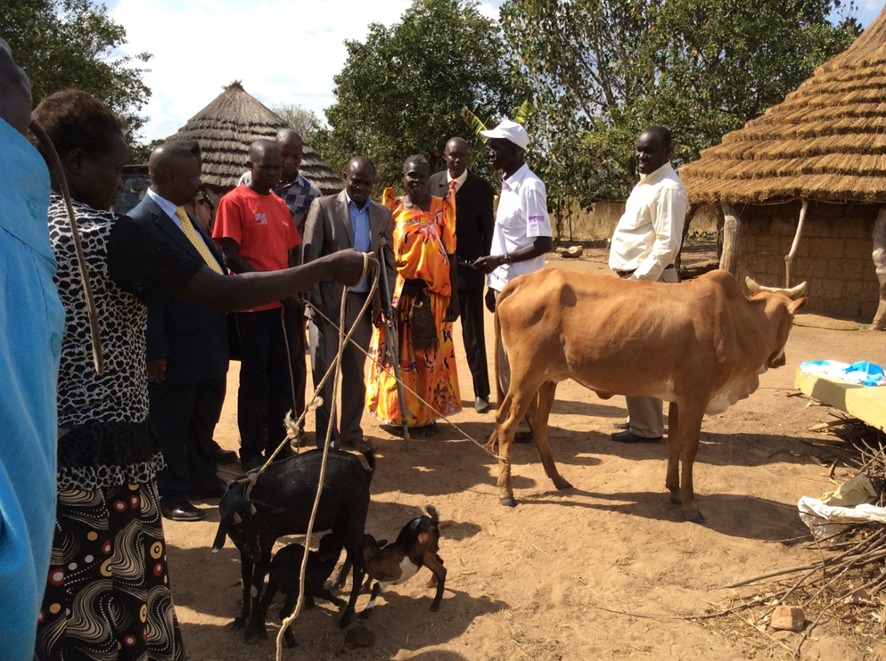
Emerging impacts
Exit point surveys consistently suggest that 20-30% of beneficiaries are regularly investing in agricultural production:
Livestock
Agricultural inputs
Hire of ox-ploughs
Hire of day-labourers
Beneficiaries are more able to wait until crops reach full maturity before selling and are in a better negotiating position with buyers, resulting in increased profitability

Slide 13
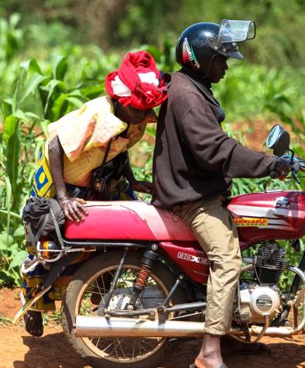
Emerging impacts
Improved food security
Increased uptake of health services
Increased uptake of education services
Increased participation, social inclusion, self esteem and empowerment, particularly amongst older women
The SCG “has improved capacity to meet not only beneficiaries’ basic needs but also those of children under their care, such as household nutrition and school expenses” (ODI, 2013)

Slide 14
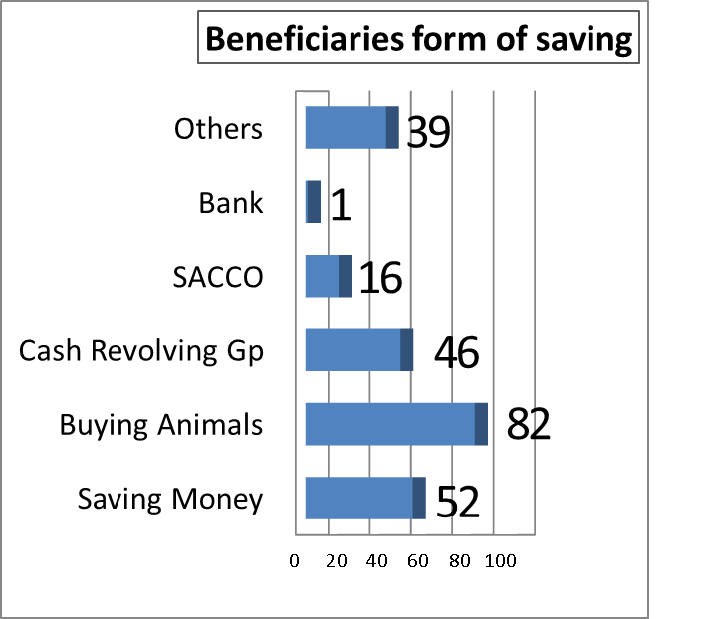
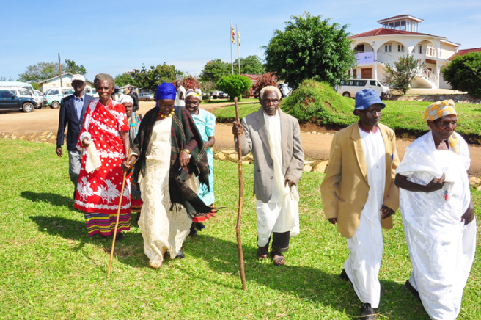
Emerging impacts
Improved access to credit through SACCOS and village savings and revolving schemes
Increased participation in local markets and economies
Improved elderly empowerment and participation in community affairs and decision making

Slide 15
NATIONAL ROLL-OUT PLAN

Slide 16
Summary of national roll-out plan
In order to reduce the short-term cost and improve social and political acceptability, MGLSD proposes to rollout to 100 oldest beneficiaries per sub county; increasing by 30% in subsequent years
Shs. 33.7 billion is required to start rollout in 2015/16
This will achieve immediate national footprint
Development partners (DFID and Irish Aid) have committed Shs. 290.6 Bn for the period July 2015 to June 2020 for :
funding the existing 15 districts till GoU takes over fully
operating costs associated with national roll-out

Slide 17
10 year financing plan for national rollout
Notes:
DFID UGX 250 bn
IA 12m

Slide 18
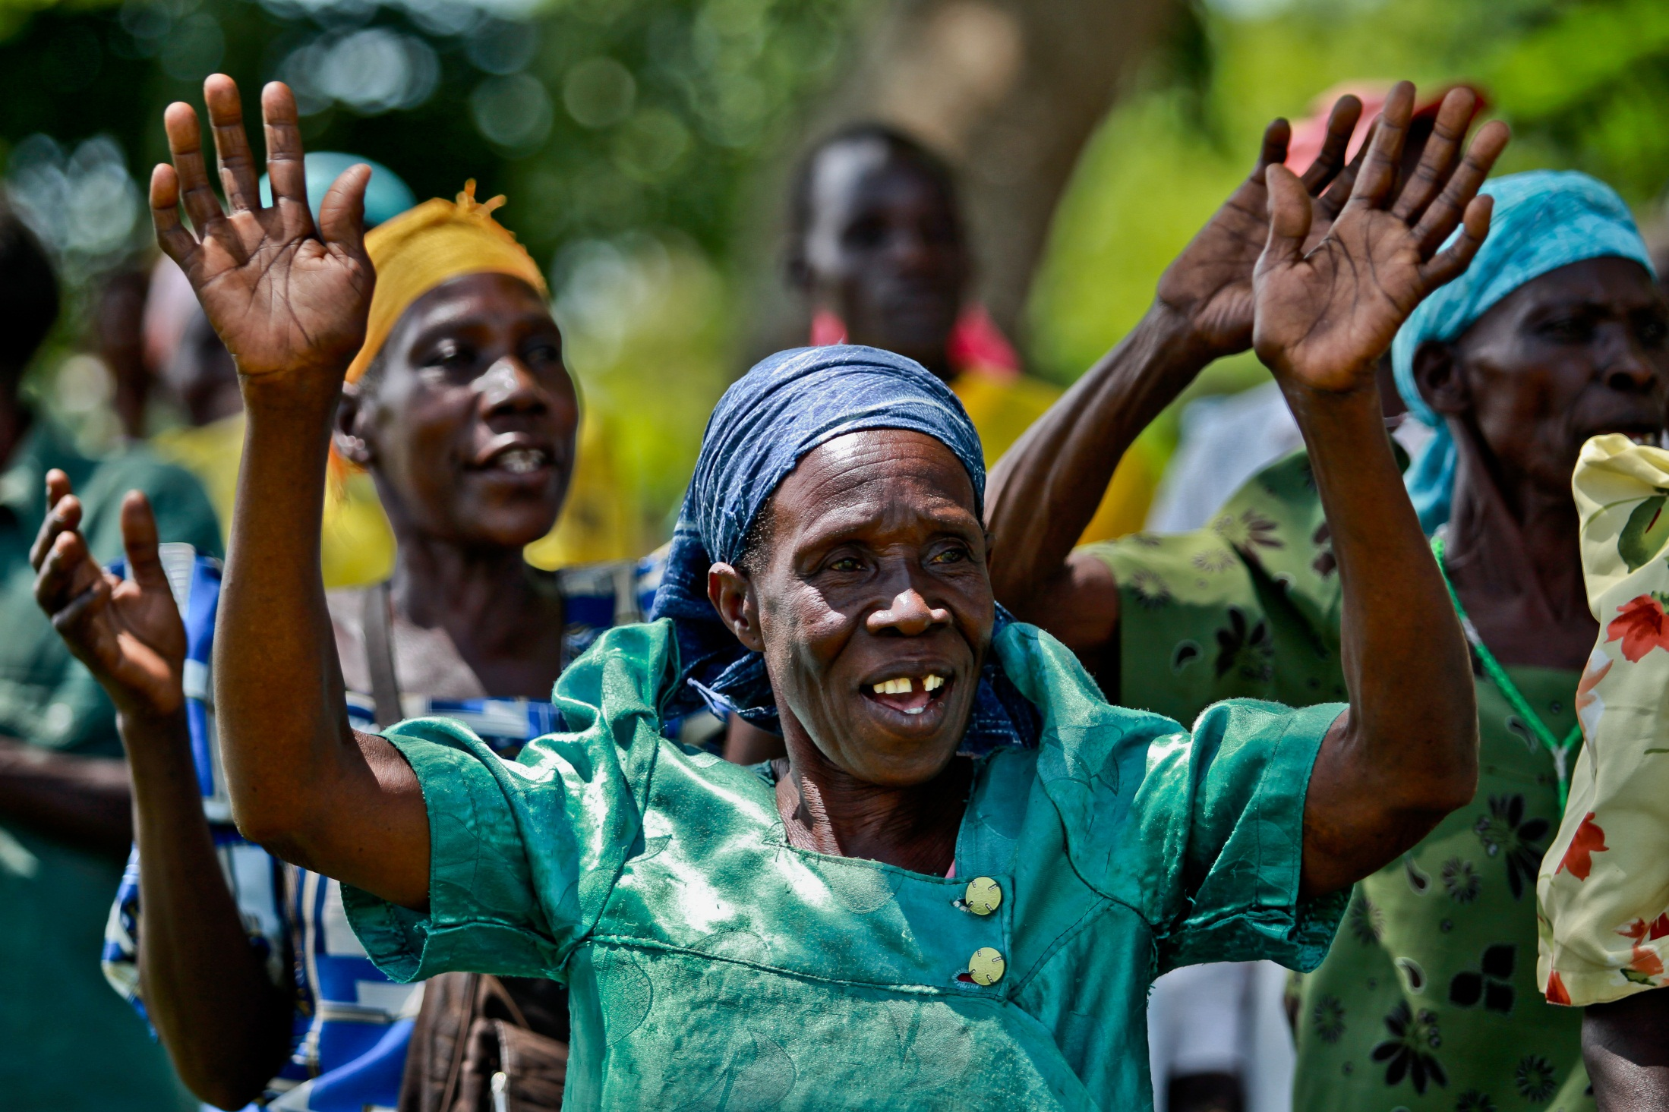
Thank You
www.socialprotection.go.ug

