Slide 1
Key lessons learnt and emerging evidence of impact of SAGE pilot
ESP, Ministry of Gender Labour and Social Development

Slide 2
ESP at a glance
Led by MGLSD since June 2010
With £50 million support from development partners
UGX 2 billion allocated in FY 2013/14 and 2014/15 to rollout SAGE to Yumbe
UGX 10 Bn additional in FY 2015/16

Slide 3
Goal
Reduce chronic poverty and improve life chances for the poor

Slide 4
Purpose
embed a national social protection system that benefits the poorest as a core element of national planning and budgeting processes

Slide 5
Outputs
Increased GoU leadership and capacity for social protection policy and programming
Viable policy and fiscal framework for social protection
Delivery of effective social transfers , through scalable systems, that generate evidence of feasibility and impact
Increased commitment to social transfers

Slide 6
Social Assistance Grants for Empowerment (SAGE) pilot
aims to generate evidence of the impact of direct income support and to develop and test delivery systems for a national system of direct income transfers
delivers two types of grants:
Senior Citizens Grants to elderly above 65 yrs (60 years in Karamoja)
Vulnerable Family Grants for households with limited labour capacity and high dependency

Slide 7
Structure of the programme
Social Protection Secretariat manages day-to-day operations
15 District SAGE offices under Community Development department up to sub-county level
Directorate of Social Protection
SP sub-committee supports development and implementation of the policy
A steering Committee chaired by PS, MGLSD provides oversight
Management Agent technically backstops the SP ecretariat
CAO provides administrative oversight

Slide 8
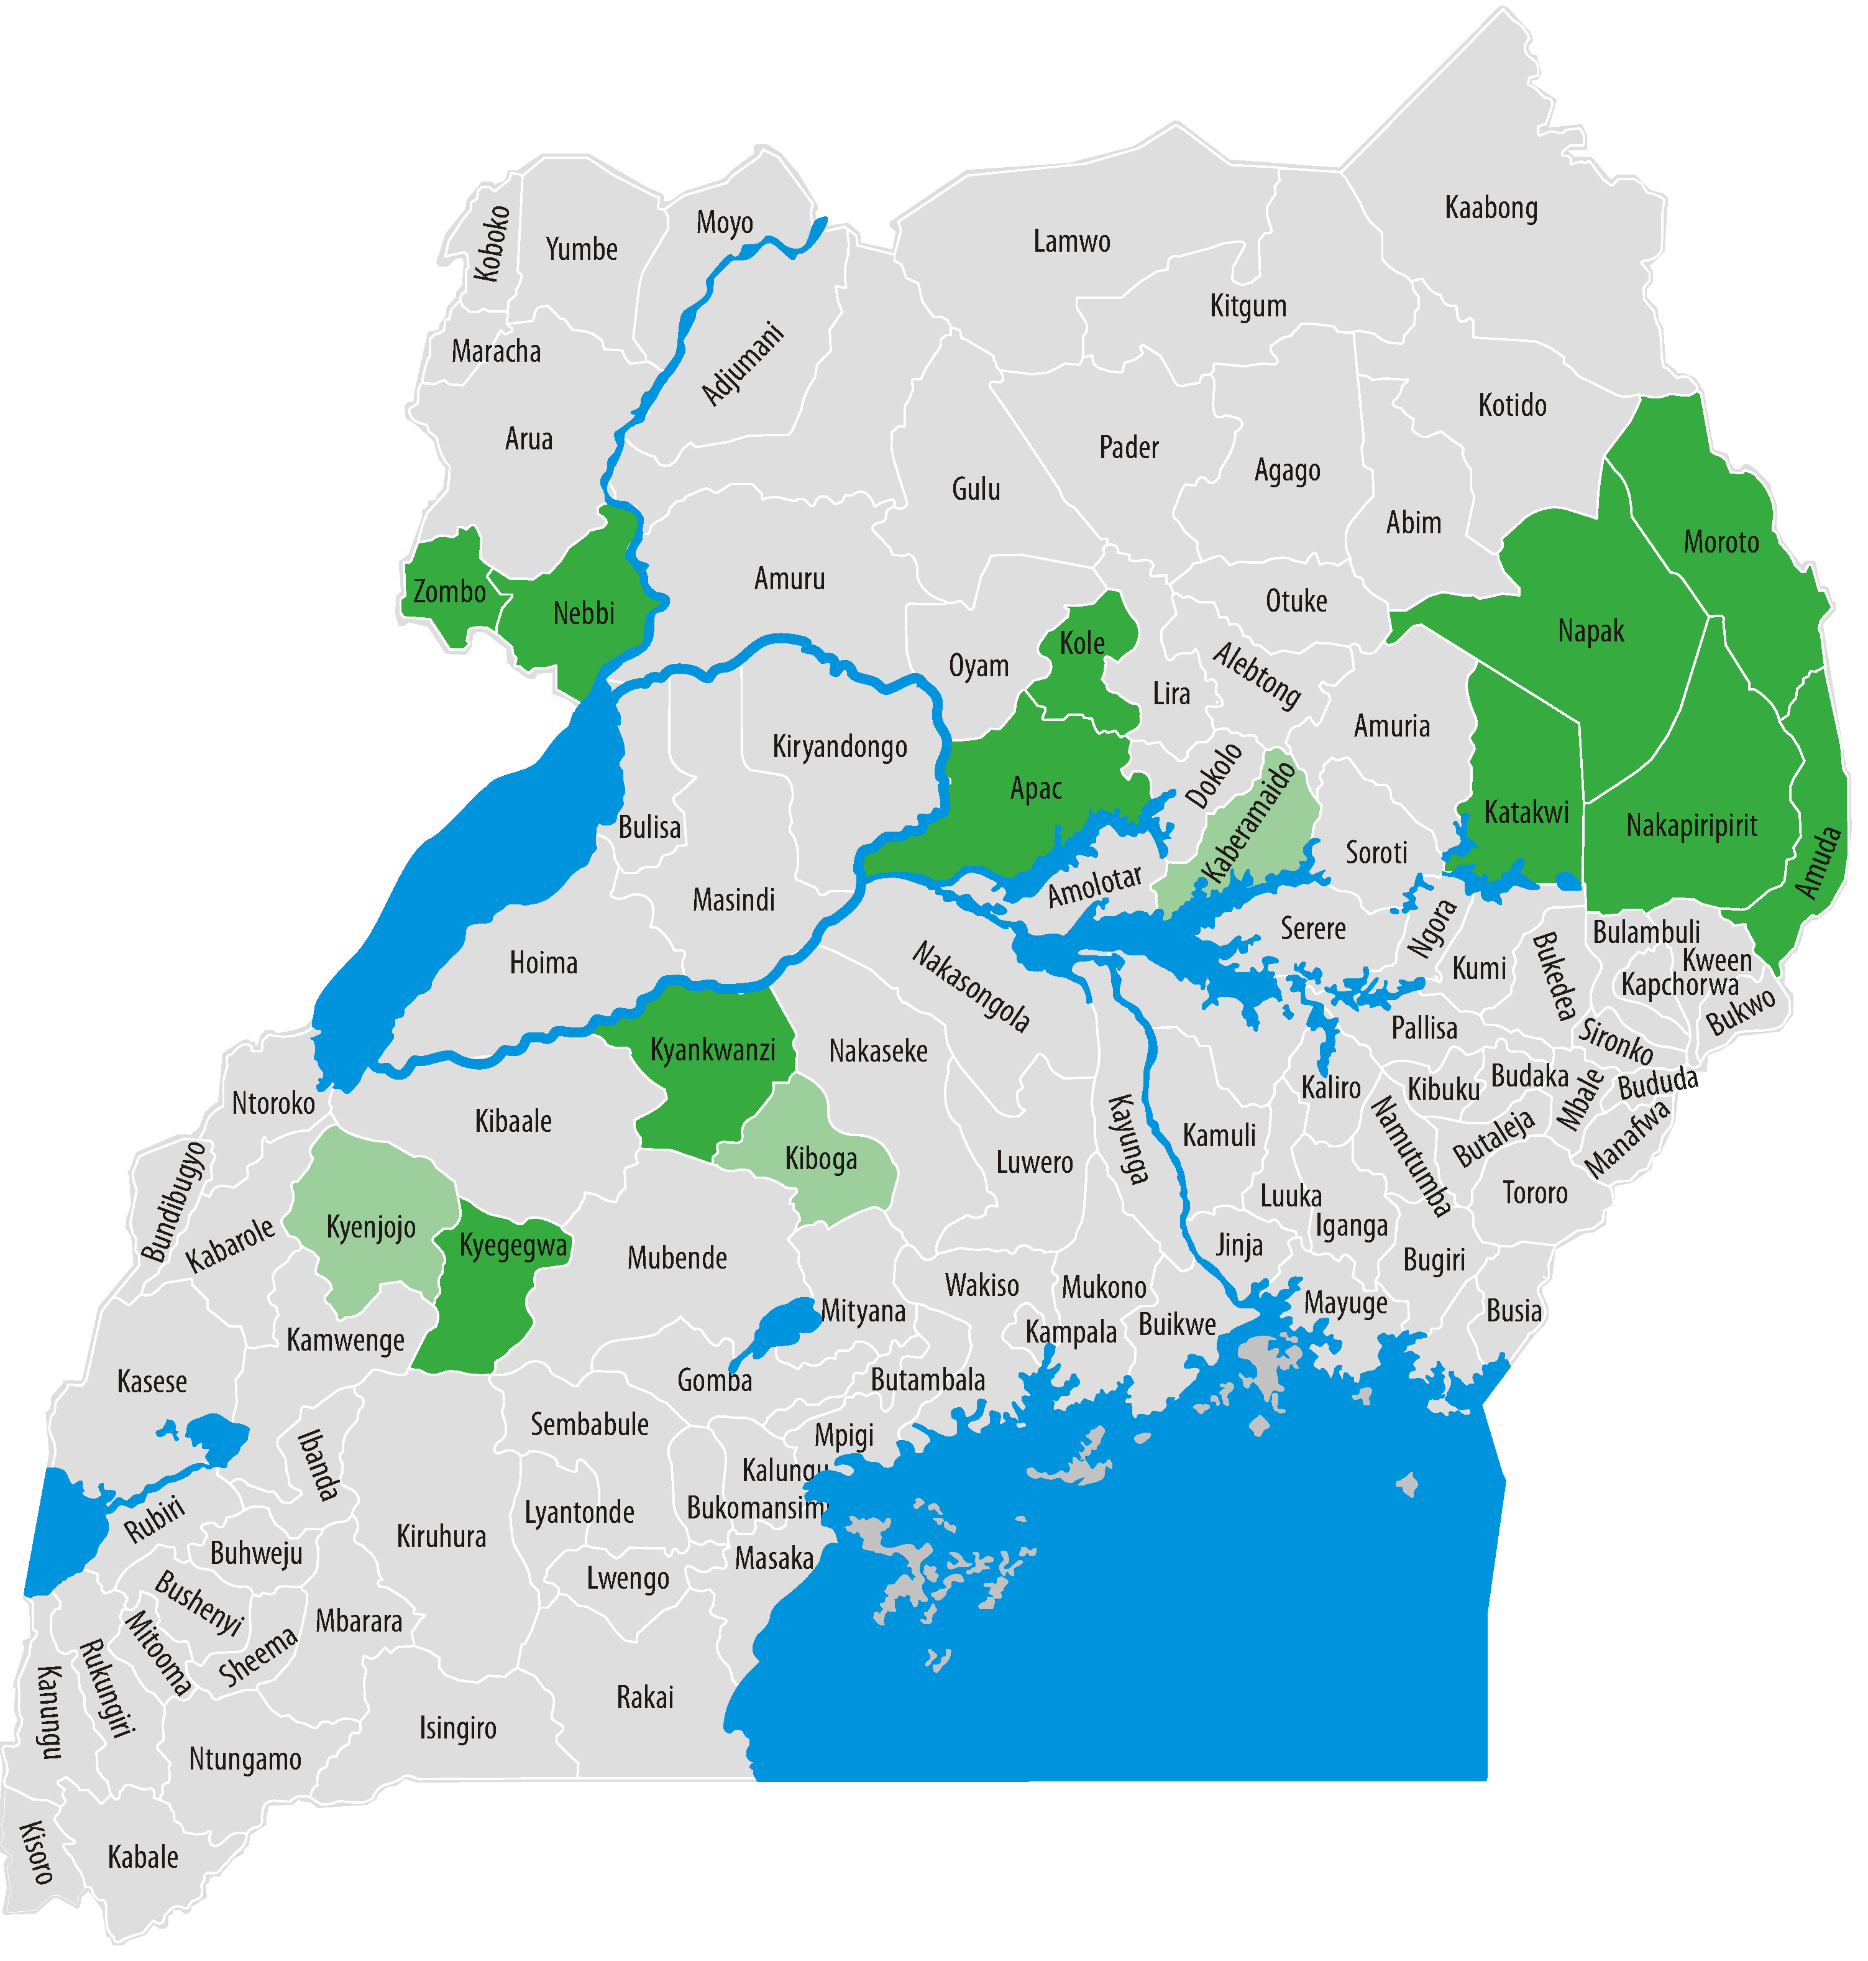
Progress-ENROLMENT
110,000 beneficiaries
15 districts
113 sub-counties
20 town councils

Slide 9
Progress: payments
UGX 63.3 bn
transferred to date
2.75 Bn p/m

Slide 10
KEY LESSONS LEARNED ON IMPLEMENTATION , EMERGING IMPACTS & SUSTAINABILITY

Slide 11
Lessons Learned to date: Implementation
The Senior Citizen Grant is a simple, cost-effective, popular and benefits many of the poorest and most vulnerable households – including children.
It is possible to reliably and cost-effectively identify SCG beneficiaries.
High levels of administrative capacity are required at national level for effective implementation.
Local governments have a role to play in implementation but require extensive support and oversight.
MTN Mobile Money system – is cost effective, efficient and accessible to most beneficiaries. 90% reliability. Requires strong oversight, risk management and contract management.
Manual payments are possible in case of poor network coverage.
Scaleable systems and institutional arrangements have been developed and tested.
Notes:
Can you check this with Pius if you haven’t already?

Slide 12
Political and institutional impacts
Overwhelming appreciation of the programme within SAGE pilot districts
“This is one of the best government programmes that directly reaches out and touches the people”.
Communities perceive the SCG as a direct reflection of the government’s increasing commitment to support the poor and vulnerable.
SAGE called ‘Nakazadde’ in Kiboga
Beneficiary selection is seen as understandable, fair, transparent and accurate.
DLGs consistently reporting that SAGE is strengthening local government through increased facilitation and coordination of structures and duty-bearers.
SAGE is increasing accountability of duty bearers to citizens.
SAGE is increasing contact between government and vulnerable citizens.
Strong demand for expansion to all districts.

Slide 13
Economic impacts
ESP micro-simulations conducted with MoFPED: 26 % of households with the elderly would be immediately lifted out of poverty if rolled out nationally.
Reduction in national poverty rate by 16% (4 percentage points)
Poverty reduction and economic impacts highly likely to multiply over time through:
Livelihoods investments – seeds, livestock, the elderly hiring youth to work untended land.
Savings and credit group formation
Increased frequency, quantity and quality of meals eaten by beneficiary households
Increased access to education & medical care

Slide 14
Social Impacts
Increased dignity, empowerment, self-esteem, confidence & participation in community affairs. Particularly among older women.
the SCG “has improved capacity to meet not only beneficiaries’ basic needs but also those of children under their care, such as household nutrition and school expenses” (ODI, 2013)

Slide 15
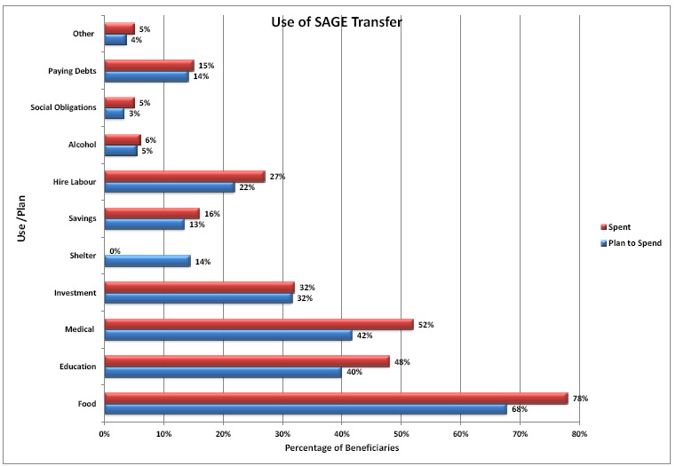
Source: ESP Exit survey

Slide 16
Source: ESP Exit survey

Slide 17
Source: ESP Exit survey

Slide 18
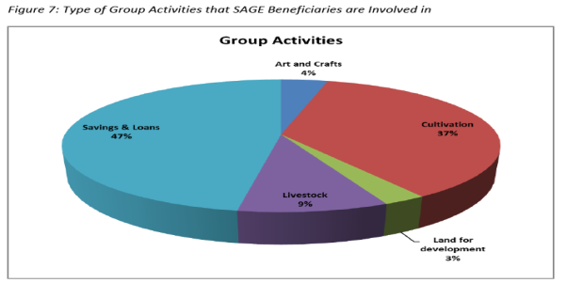
Source: ESP Exit survey

Slide 19
The road to transformation…
Baseline: Poverty and vulnerability

Slide 20
The road to transformation…
Access to services

Slide 21
The road to transformation…
Saving and productive investments

Slide 22
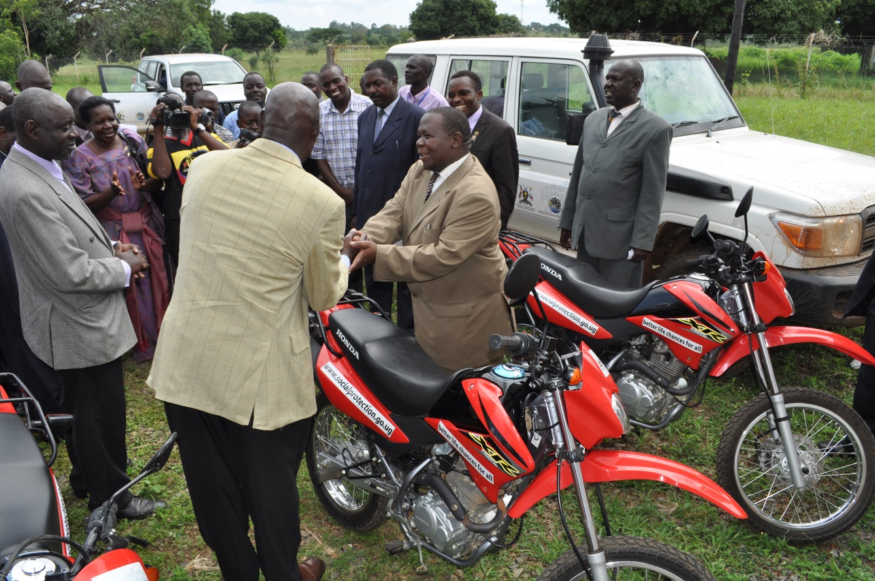
The road to transformation…
Political and institutional impacts

Slide 23
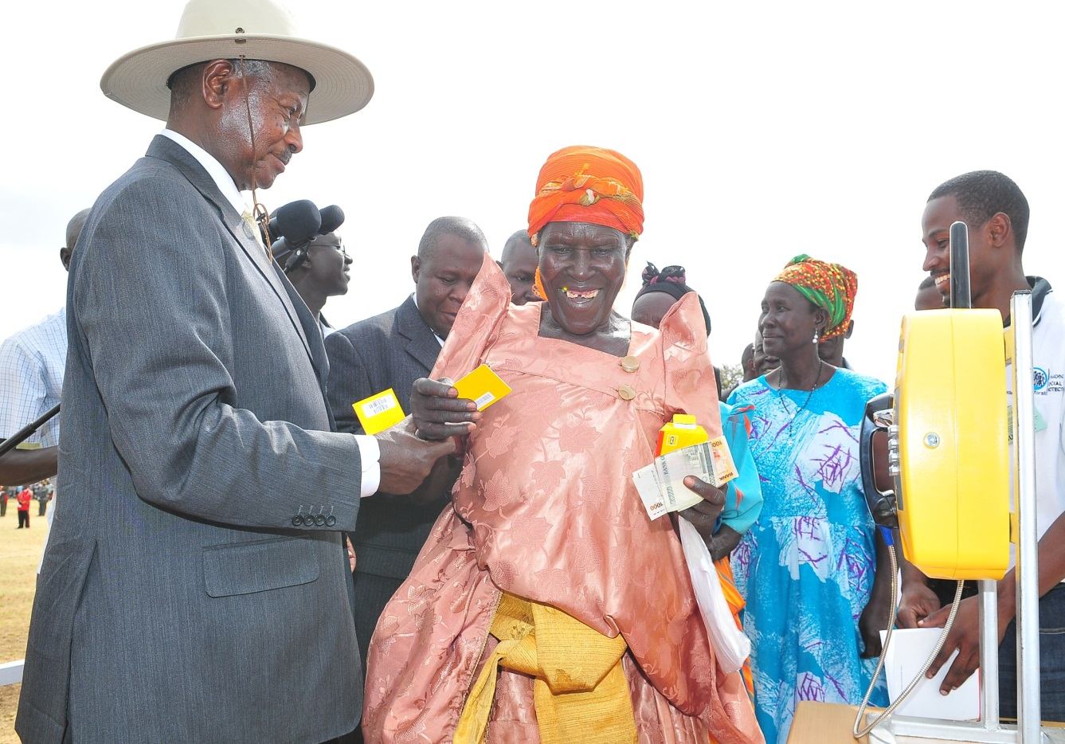
The road to transformation…
Political and institutional impacts

Slide 24
The road to transformation…
Political and institutional impacts

Slide 25
The road to transformation…
Political and institutional impacts

Slide 26
Social cohesion
SCG is popular and acceptable

Slide 27
Thank you!

