Slide 1
Brief on the
-Expanding Social Protection Programme
-National vision for a SP system
-SCG rollout plans
Titus Ouma, Training Officer,
Expanding Social Protection Programme
Ministry of Gender Labour and Social Development
May 2015

Slide 2
Outline of Presentation
Rationale and strategic importance of social protection
Overview of ESP programme and summary of achievements and impacts to date
Uganda’s vision for a comprehensive SP system
Financial Sustainability : SCG rollout options

Slide 3
Rationale and strategic importance of SP in national development
Uganda’s Vision 2040 : transforming from a peasant to a modern and prosperous country by 2040, while ensuring that no one is left behind.
This vision follows impressive economic performance and a series of poverty reduction strategies over the last 2 decades
Steady GDP growth at 7% on average
Poverty reduced from 56.4 % in 1992 to 19.7 % in 2013.
But poverty , inequality of opportunity and vulnerability remain challenging to Uganda’s development!

Slide 4
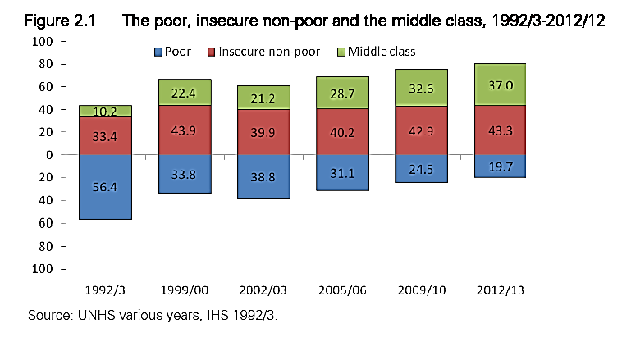

Slide 5
Rationale and strategic importance of SP in national development
The large number employed in the agricultural sector are vulnerable to:
climatic shocks,
pests, plant and animal diseases
and price fluctuations;
and those working in the informal sector usually receive low and irregular income.
Poverty and vulnerability has cyclic effects with serious implications for long-term human development:
Inadequate nutrition, limited access to health and education means that children cannot develop to their full potential to attract better returns to their future labour ;
Yet poverty induced increases risk aversion and leads to suboptimal household economic decisions; low self esteem and social exclusion leading to the intergenerational transfer of poverty and vulnerability
Notes:
Why are people vulnerable
What is the risk

Slide 6
Rationale and strategic importance of SP in national development
Although Uganda has a strong tradition of extended family support this system is under strain due to:
persistent poverty
Rapid modernisation and urbanisation
HIV/AIDS providing
Yet, access to formal social security is extremely limited e.g. only 5% of working population are covered by formal pension scheme and only 4.5% receive some form of direct income support
NSSF: 400,000 members
PSPF: 51,000 members
Public works: 500,000 beneficiaries/year
Notes:
Declining social support systems; limited coverage

Slide 7
Rationale and strategic importance of SP in national development
MGLSD’s vision is therefore to establish a Social Protection system as part of the core government policy and planning processes to:
reduce vulnerability to shocks and thereby
prevent deterioration of living standards and reduce poverty
support households to build more secure and resilient livelihoods.

Slide 8
ESP at a glance
Approved by Cabinet in June 2010
Led by MGLSD with £51 million support from development partners
UGX 2 billion allocated in FY 2013/14 and 2014/15 to rollout SAGE to Yumbe

Slide 9
Goal of the ESP programme:
Reduce chronic poverty and improve life chances for the poor

Slide 10
Purpose of ESP programme :
The objective is to embed a national social protection system that benefits the poorest as a core element of national planning and budgeting processes

Slide 11
Outputs
Increased GoU leadership and capacity for social protection policy and programming
Viable policy and fiscal framework for social protection
Effective delivery systems and evidence of feasibility, impact and affordability through the SAGE pilot
Increased awareness and commitment to Social Protection

Slide 12
Structure of the programme
Social Protection Secretariat manages day-to-day operations
15 District SAGE offices under Community Development department up to sub-county level
Directorate of Social Protection
A steering Committee chaired by PS, MGLSD provides oversight
Management Agent technically backstops the SP ecretariat
CAO provides administrative oversight

Slide 13
Summary of KEY achievements to date

Slide 14
Key achievements
Capacity for management and leadership for Social Protection has being built at both central and local government levels
Over 10,000 LG staff trained
Office space and equipment
Motor vehicles
Generators
etc

Slide 15
Key achievements
A clear vision for a Social Protection system has evolved through consultations with stakeholders :
A draft Social Protection policy framework has been approved by MGLSD management.
Detailed Programme Plans of Intervention (PPI) are being developed.

Slide 16
Key achievements
An Institutional Development Strategy has been developed and is being implemented:
Owing to this success, DPs have expressed interest to provide another 5 years of support for ESP phase 2- UGX 290 bn in total

Slide 17
Key achievements
Robust systems and processes for beneficiary registration and payment have been developed ready to implement SAGE nationally.
MTN Mobile Money system is accessible to most beneficiaries with 90% reliability.
UGX 72 bn
transferred to date
2.75 Bn p/m

Slide 18
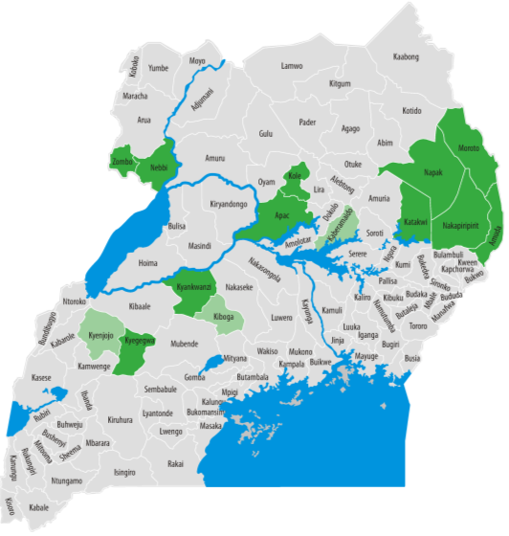
Key achievements
114,000 beneficiaries enrolled
15 districts
141 sub-counties /town councils
6028 villages

Slide 19
Key achievements
Overwhelming appreciation of the programme within SAGE pilot districts
“This is one of the best government programmes that directly reaches out and touches the people”.

Slide 20
Key achievements
Due to increased public support, H.E. the President has directed the MGLSD and MFPED to:
Extend the SAGE pilot to Yumbe
develop and publish a plan for national rollout of the SCG

Slide 21
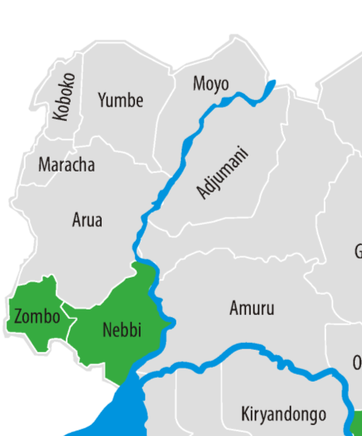
Key achievements-Yumbe is
A dedicated office established
6800 beneficiaries enrolled in 7 sub counties
Payments started in August 2014
However, enrolment of 4200 beneficiaries in 5 sub-counties awaiting release of additional funds from MFPED

Slide 22
Pictorial, Yumbe Launch

Slide 23
Emerging impacts of the SAGE programme

Slide 24
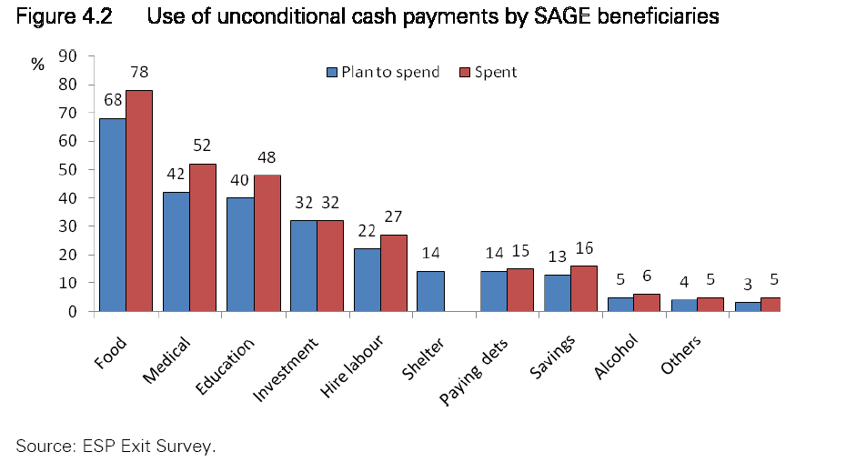

Slide 25
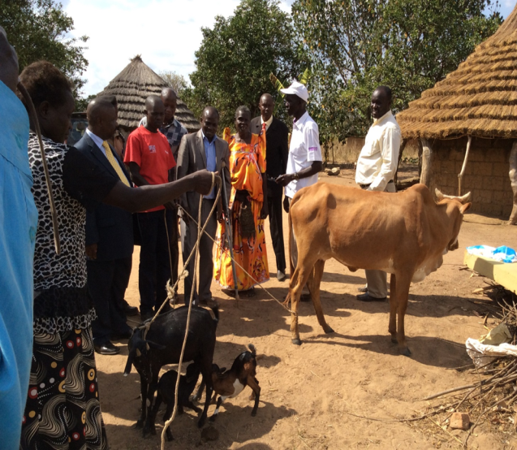
Emerging impacts
20-30% of beneficiaries are regularly investing in agricultural production:
Livestock
Agricultural inputs
Hire of ox-ploughs
Hire of day-labourers
Beneficiaries are more able to wait until crops reach full maturity before selling and are in a better negotiating position with buyers, resulting in increased profitability

Slide 26
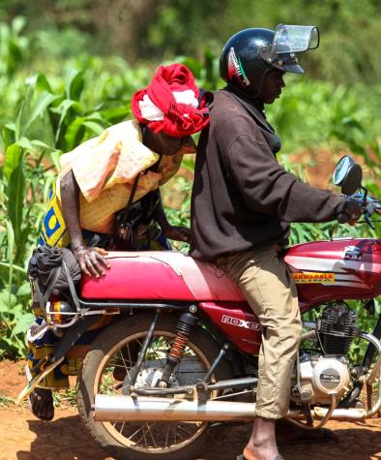
Emerging impacts
Improved food security
Increased uptake of health services
Increased uptake of education services
Increased participation, social inclusion, self esteem and empowerment, particularly amongst older women

Slide 27
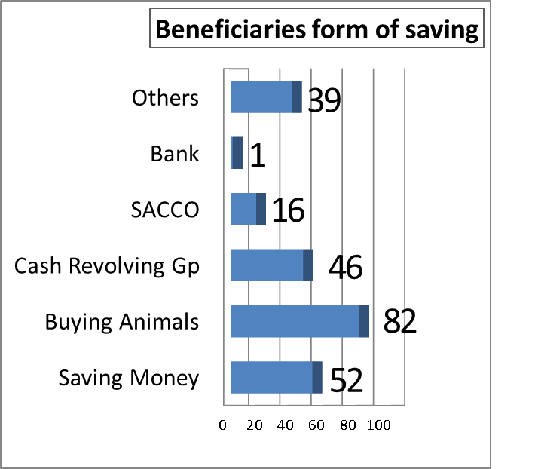
Emerging impacts
Improved access to credit through SACCOS and village savings and revolving schemes
Increased participation in local markets and economies

Slide 28
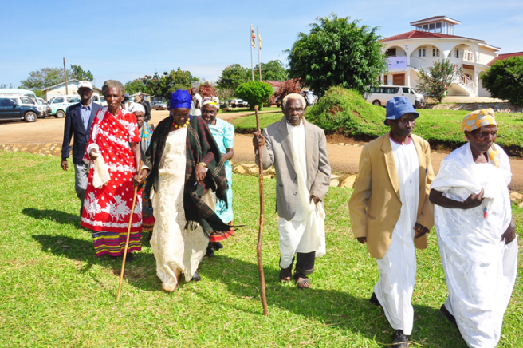
Emerging impacts
Improved elderly empowerment and participation in community affairs and decision making

Slide 29
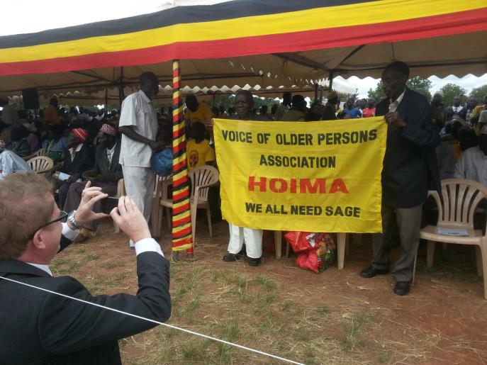
Political and institutional impacts
Overwhelming appreciation of the programme within SAGE pilot districts
Strong demand for expansion to all districts.
DLGs consistently reporting that SAGE is strengthening local government through increased facilitation and coordination of structures and duty-bearers.
SAGE is increasing contact between government and vulnerable citizens.

Slide 30
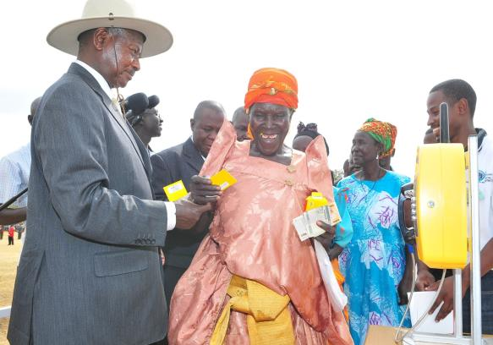
Emerging impacts
Communities perceive the SCG as a direct reflection of the government’s increasing commitment to support the poor and vulnerable.
SAGE is called ‘Nakazadde’ in Kiboga

Slide 31
Uganda’s vision for a comprehensive SP system: Overview of draft SP policy and other sector reforms
SP policy objectives
To expand the scope and coverage of contributory social security
2. To scale up the provision of direct income support to individuals and households with inadequate livelihood options and limited economic opportunities

Slide 32
Uganda’s vision for a comprehensive SP system: Overview of draft SP policy and other sector reforms
SP policy objectives
To enhance the capacity of formal and informal institutions to provide holistic social care and support services to socially vulnerable individuals
4. To strengthen institutional framework for delivery of coordinated social protection services

Slide 33
Rollout plans, 2015/16
Due to increased public demand, rollout proposals re-submitted to MFPED and H.E. the President for review
Cabinet Memo was submitted in Jan 2015
Agreed rollout plan will be incorporated in the BFP
UK Secretary of State has approved negotiation for a second 5 year phase to support
SAGE in 14 districts
Support to national rollout

Slide 34
national roll-out plan-option 1
Full district roll-out | 2015/16 | 2016/17 | 2017/18 | 2018/19 | 2019/20
Cumulative Districts | 24 | 49 | 74 | 99 | 112
Cumulative grantees | 220,160 | 463,877 | 722,967 | 998,164 | 1,149,027
% coverage of eligible older people | 21% | 43% | 65% | 88% | 100%
Cost (Shs. Bn) (2014 prices) | 47.6 | 123.5 | 206.5 | 293.8 | 387
Note: Admin costs est. at 13.7% during the operationally intensive four-year roll-out phase but projected to reduce to 7% over the longer-term

Slide 35
national roll-out plan-option 2
In order to reduce the short-term cost and improve social and political acceptability, MGLSD proposes to rollout to 100 oldest beneficiaries per sub county; increasing by 30% in subsequent years
Shs. 33.7 billion is required to start rollout in 2015/16
This will achieve immediate national footprint
Development partners (DFID and Irish Aid) have committed Shs. 290.6 Bn for the period July 2015 to June 2020 for :
funding the existing 15 districts till GoU takes over fully
operating costs associated with national roll-out

Slide 36
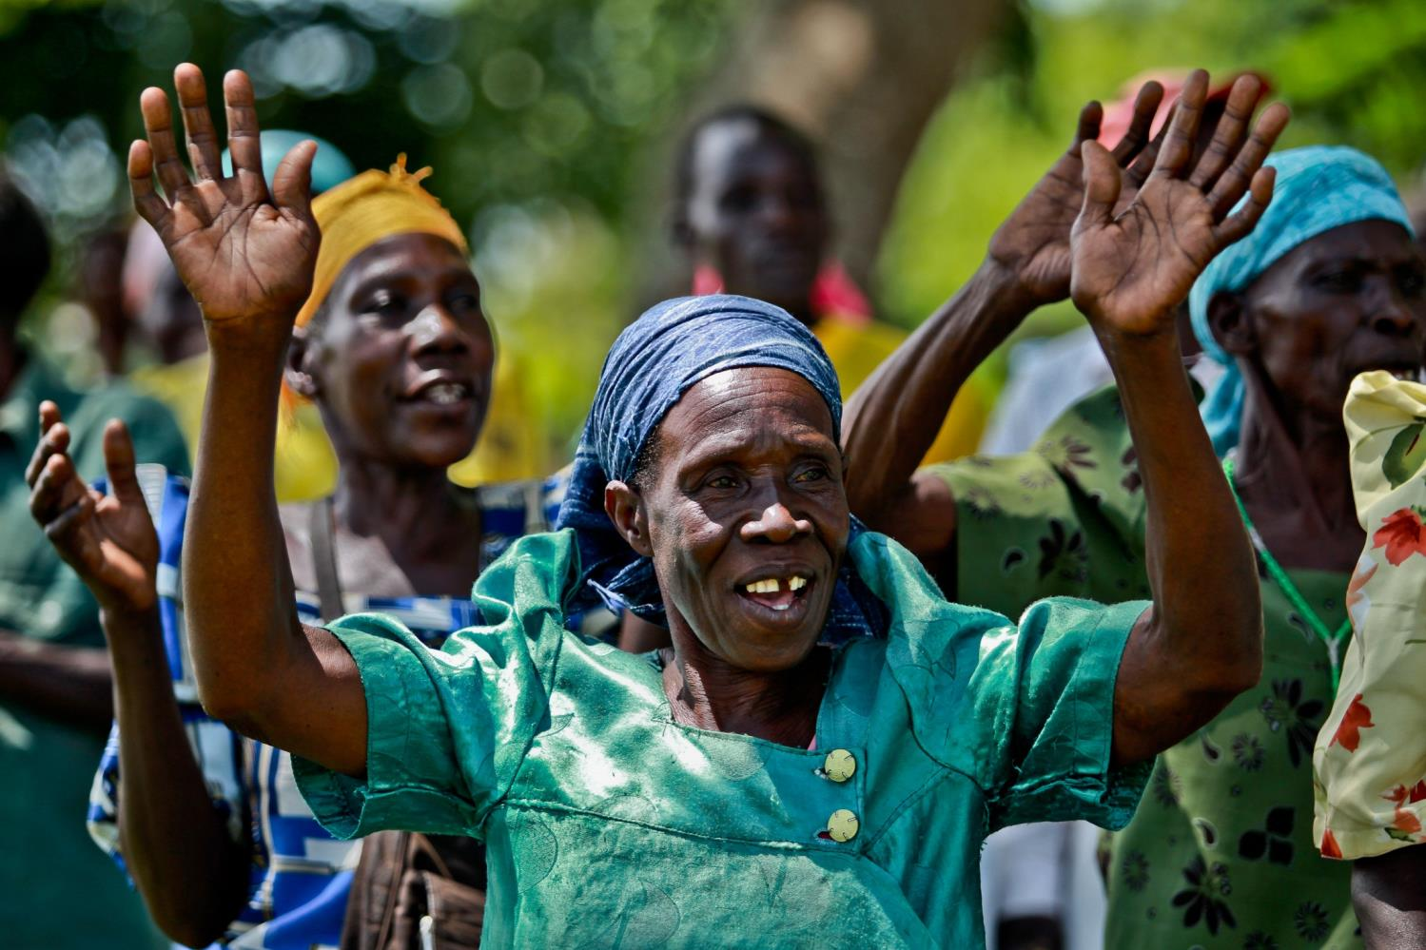
Thank You
www.socialprotection.go.ug

